Slide 1

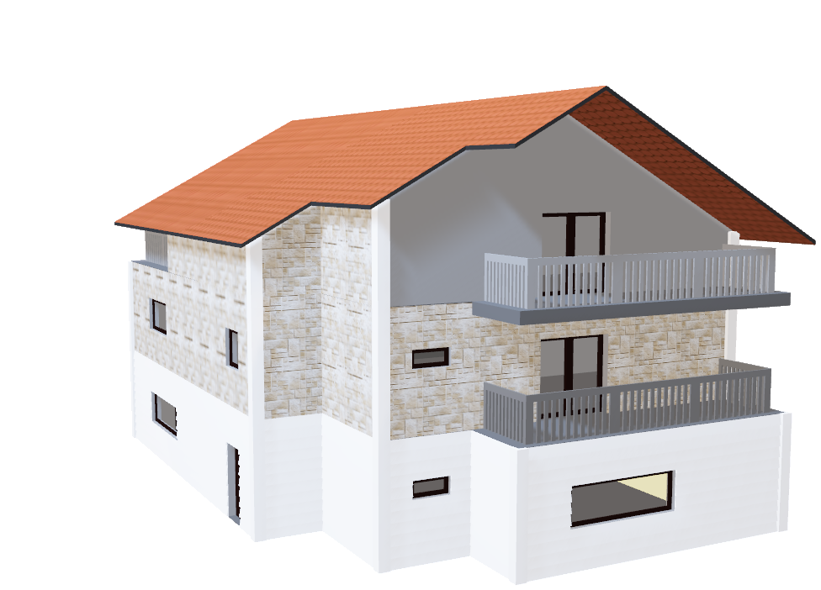
Connecting with realtors on home pricing intuition based on data science
Location, Location, Location ?!
Rebecca Mih

Slide 2

Traditional Home Value Intuition
In a nutshell, location, location, location means homes can experience large increases or decreases in value due to nothing other than their location. The saying's repeated three times for emphasis, and it is the number one rule in real estate, while also often the most overlooked. - Google
Location can mean different things to different people
Other Features: Living Area, #Bedrooms, #Baths
Data Science Insights

Slide 3
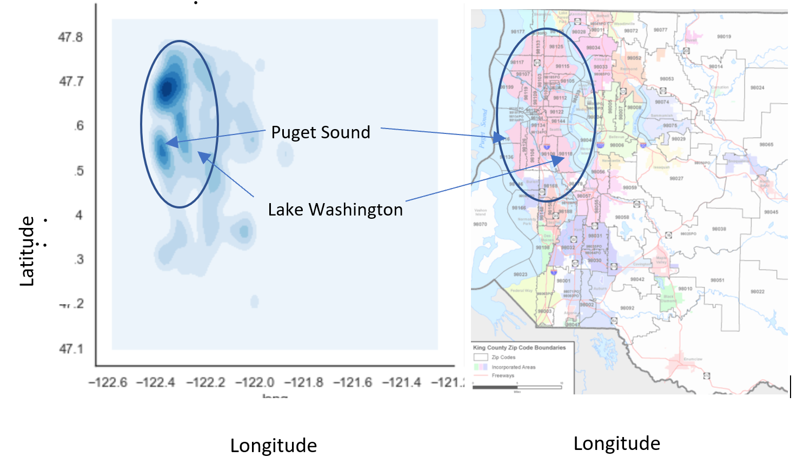
Data Scope
King County, Washington
Single Family Homes
May 2014 – May 2015
Darker Blue = More Home Sales
Can Data Science Help With These Questions:
Trends between Location and Price ?
Is there a significant difference between house prices on the peninsula versus away from the coastline ?
What’s the value of a Waterfront View ?
What other factors are key for increasing home prices?
Highes Sales Concentration:
Olympic Peninsula / Lake Washington areas

Slide 4
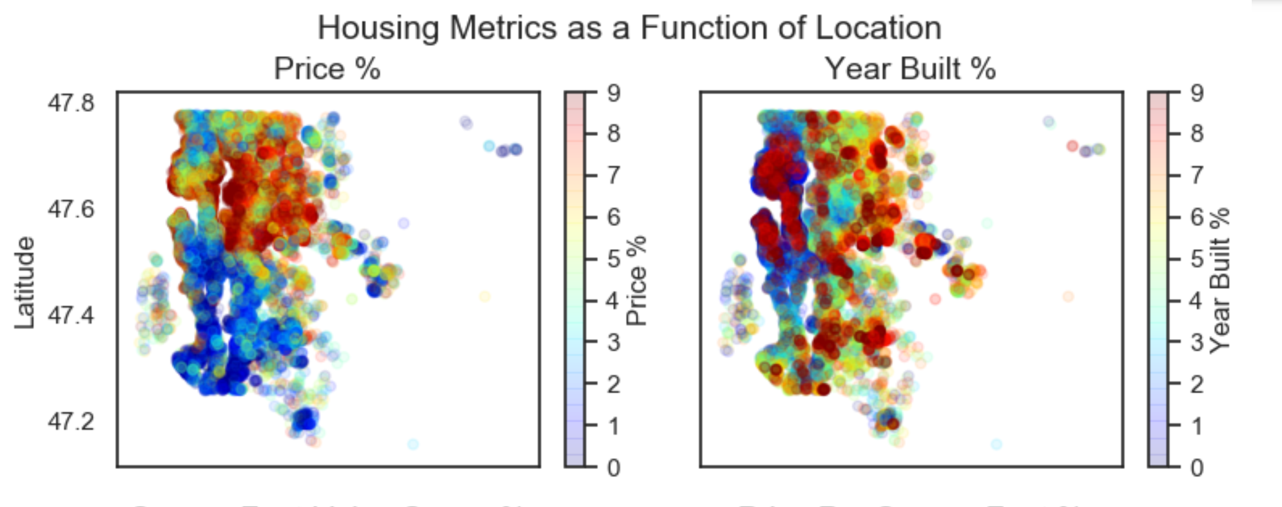
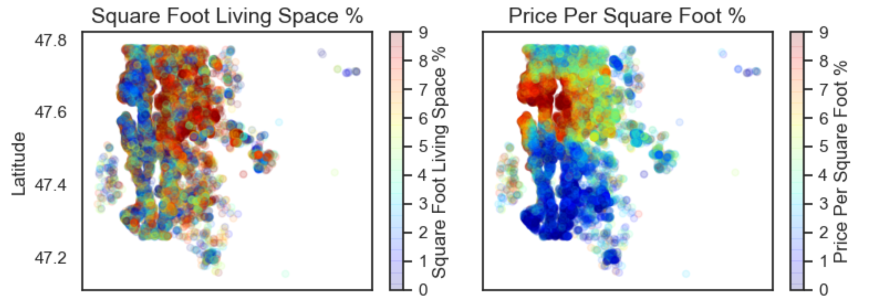
Housing Metrics as a Function of Location
Start with traditional metrics
Price Per Square Foot Trends Smoothly
Highest prices on coastline and inland
Newest homes not on the coastlines. Oldest homes on the coastlines
Price Per Square Foot seems to have captured the key features in pricing, in a rational manner
Largest Homes to the East of Lake Washington. Smallest homes predominantly on the peninsula
Highest Price per Square Foot on the peninsula, and moving east of Lake Washington

Slide 5
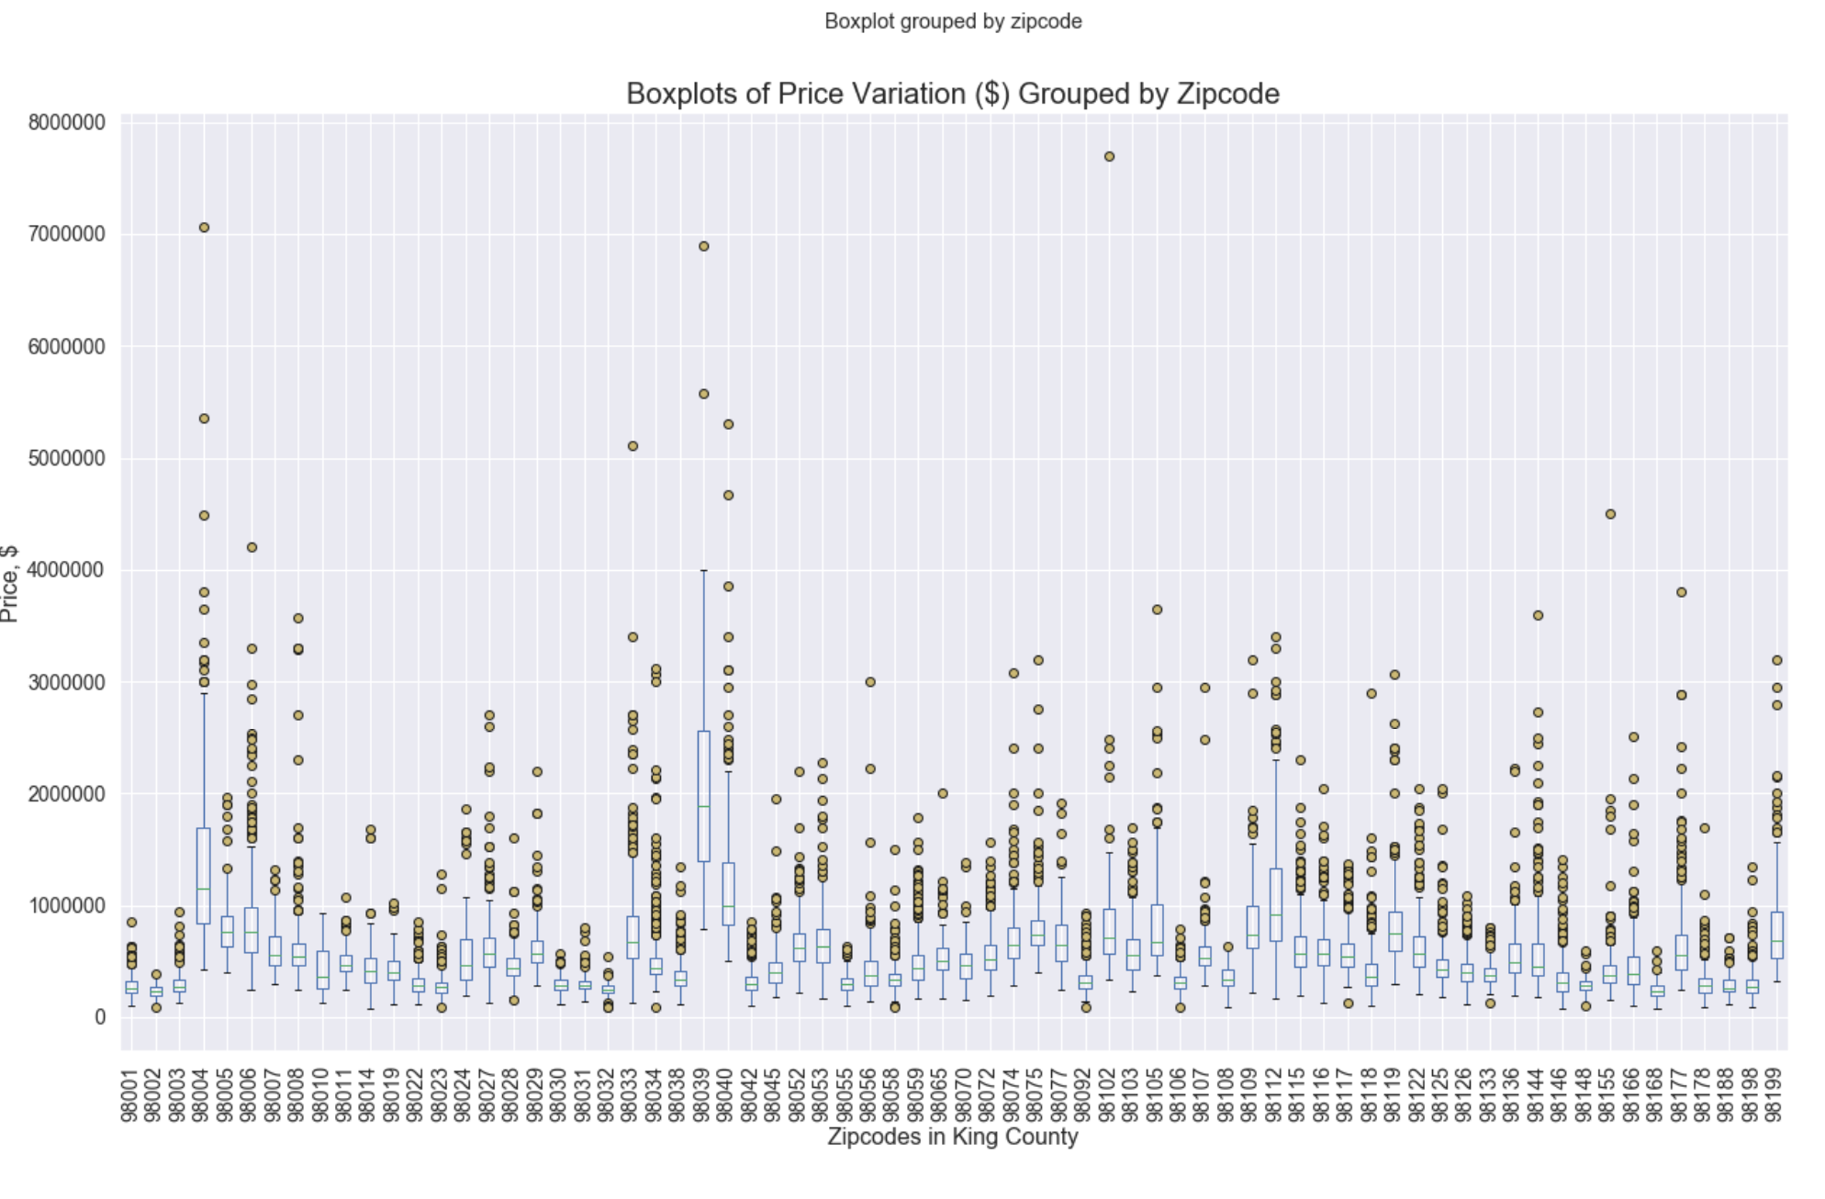
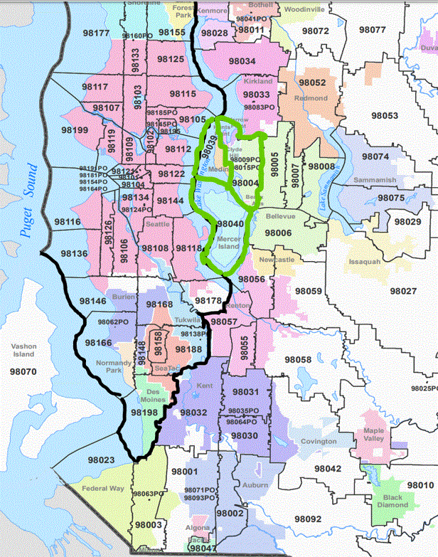
Zip Codes Versus Price
Median Price  10% for 981XX zips*
004
Key Areas
Median Price
> $1M
039
980XX zips
981XX zips
981XX zips
040
980XX zips
Median House Price w/o key areas

Slide 6
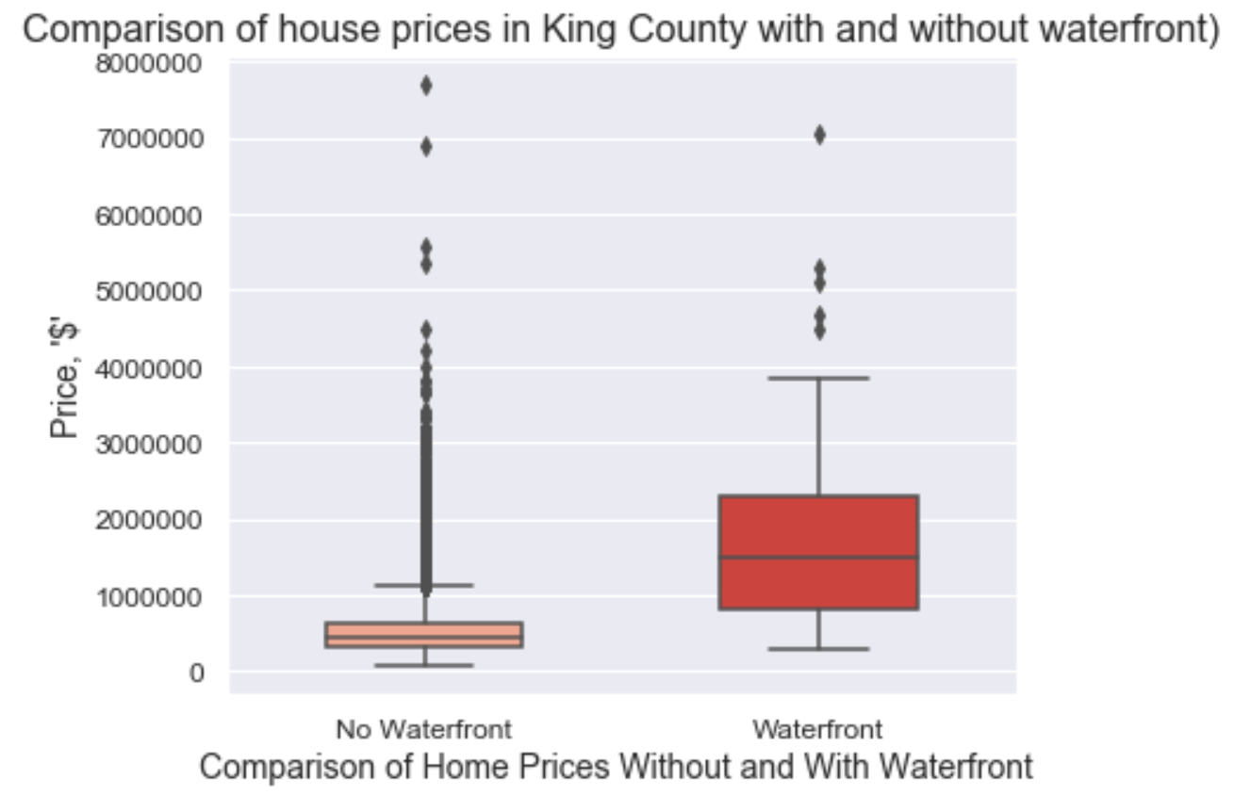
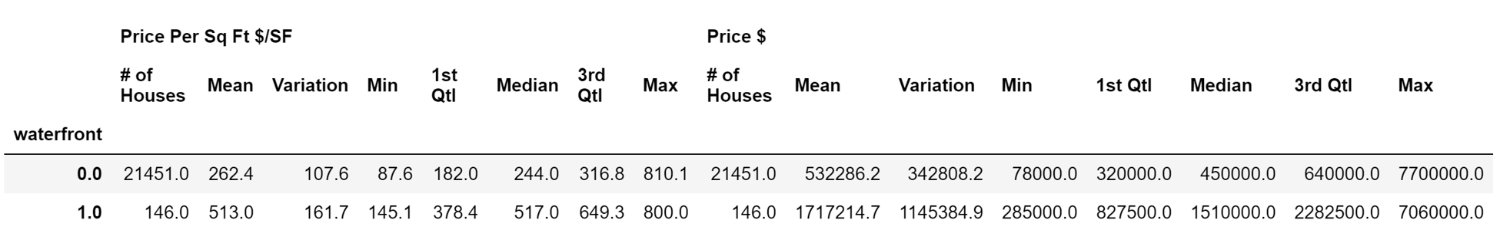

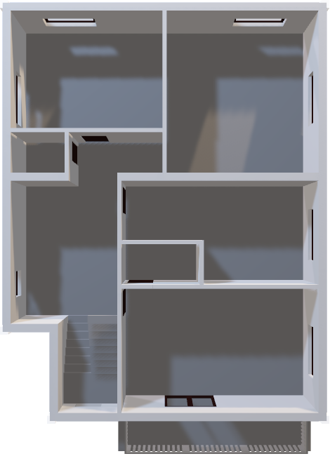
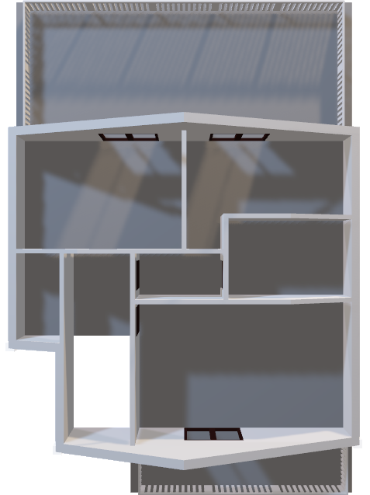
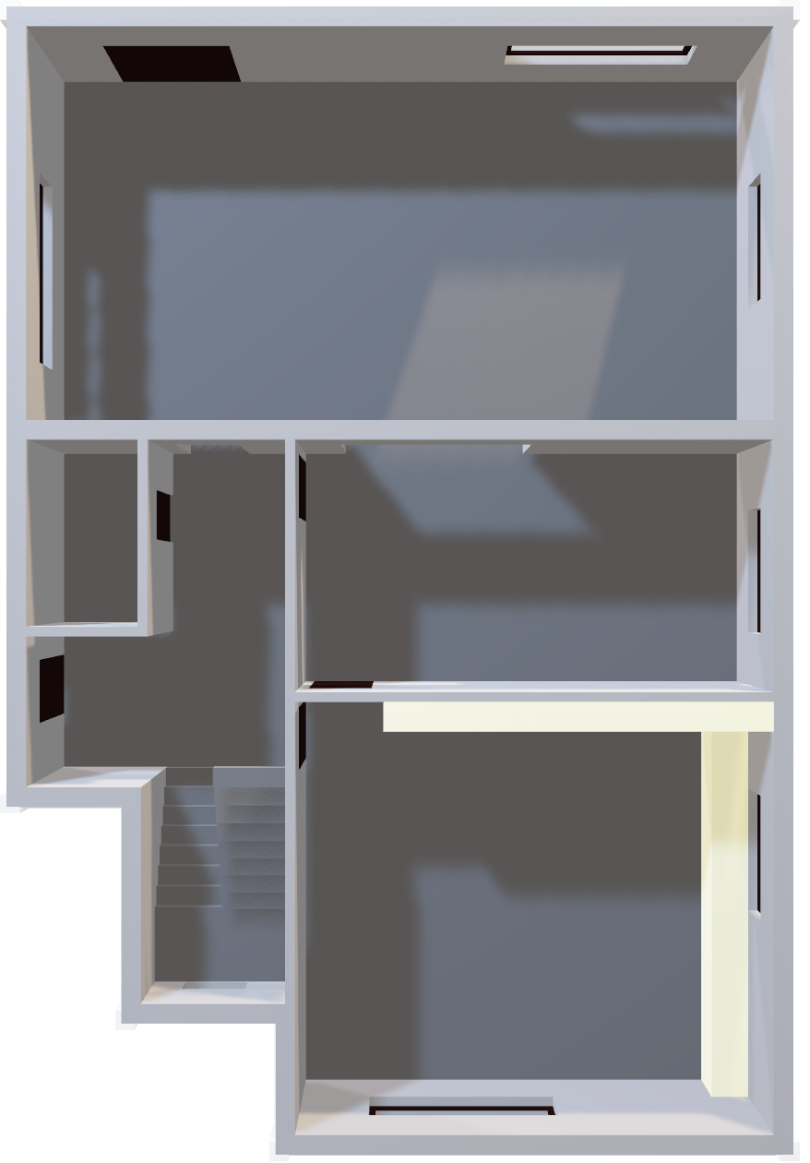
Value of a Waterfront View
Roof
Waterfront Views are intuitively value
But how much value do we place on it ?
The Median Price per Sq Ft is ~ 2X more for waterfront view properties
The Median Home Price may be up 3X more for a Waterfront
3rd Floor
2nd Floor

Slide 7
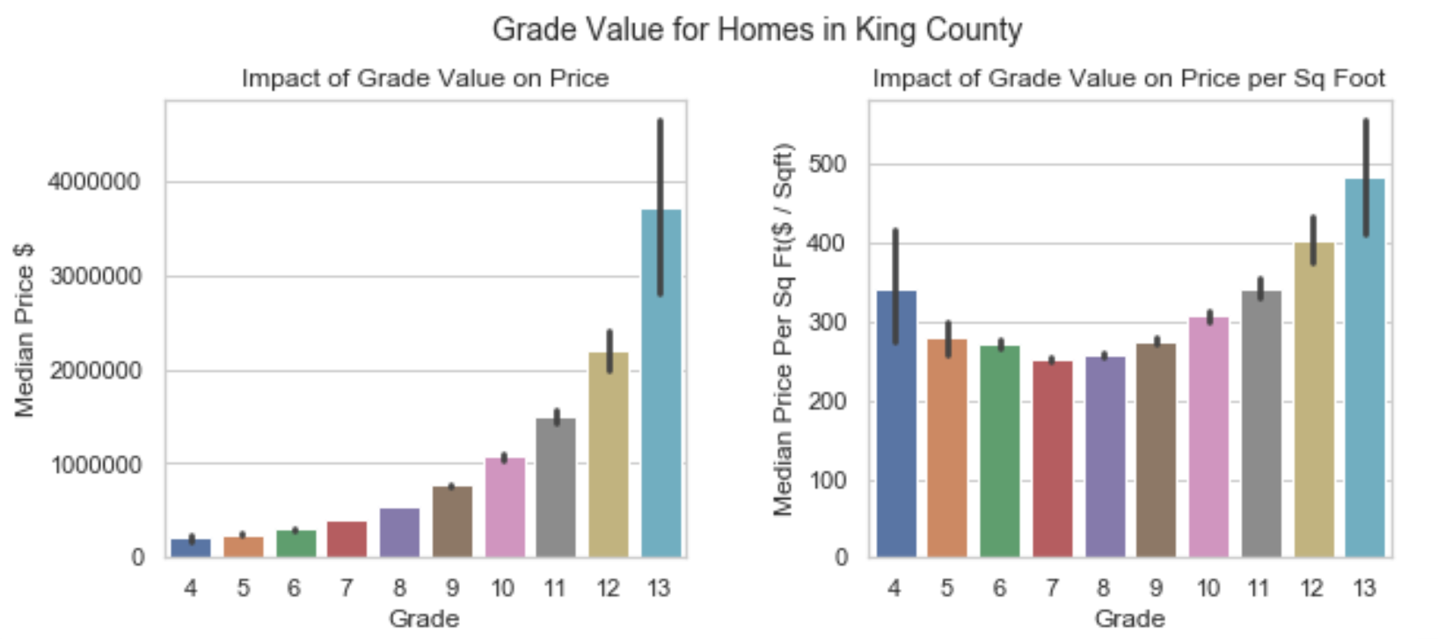
The Value of Grade
What were the most important features as determined by the model fitting ?
Changes of grade greatly increase median home value ~40% per grade
Consistently: Latitude, Grade, Living area, Age of the house.
Most of these make intuitive sense.
Of those, the Grade is one of the few factors which potentially could be improved by homeowners
Changes of grade increase median Price Per SqFt, but other factors also impotant

Slide 8
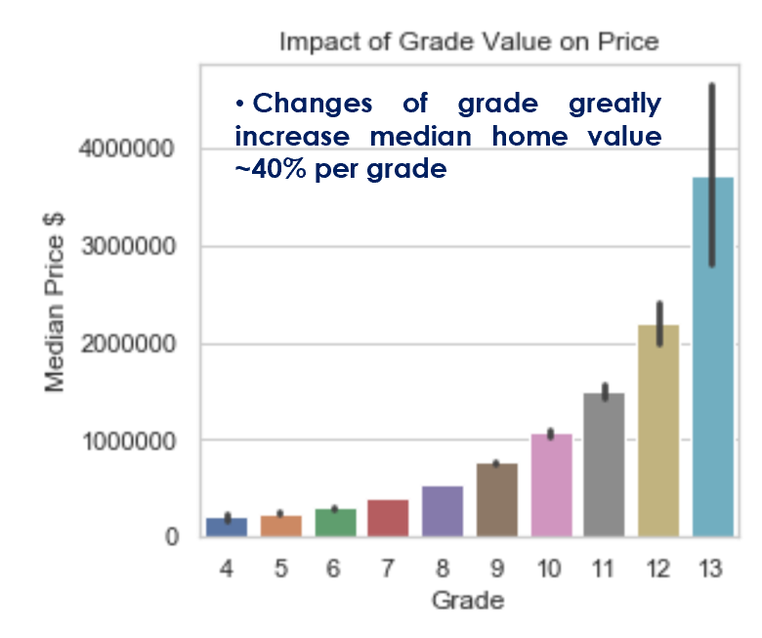
Summary
Location:
Price per Sq. Ft. systematically tracks to latitude. Use this data for future pricing
Location:
Still important, zipcodes shown only 10% Median house price 
Waterfront Views
Worth ~2x  Median Price
Up to 3X  Price/SqFt
Grade improvements may be the best way to increase home price (2X or more)

Slide 9
Thanks !

Slide 10
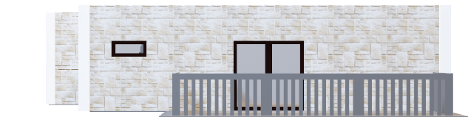

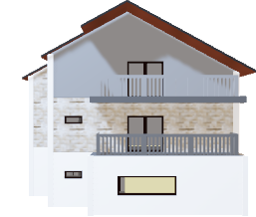

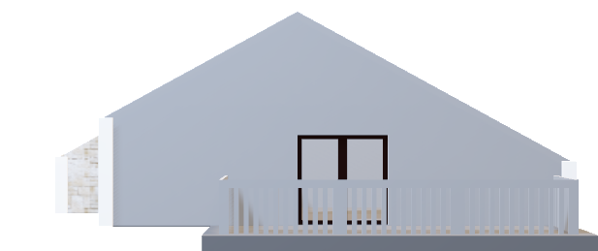
Summary
Location:
Price per Sq. Ft. systematically tracks to latitude. Use this data for future pricing
Location:
Still important, zipcodes shown only 10% Median house price 
Waterfront Views
Worth ~2x  Median Price
Up to 3X  Price/SqFt
Grade improvements may be the best way to increase home price (2X or more)

